Slide 1
Building Semantic Search using Elasticsearch May 2020

Slide 2

Ilham Bintang
+6285 156 919 679
t.me/nullphantom
github.com/nullphantom
linkedin.com/in/nullphantom
Machine Learning Engineer
abin.web.id
Projects:
Building NLP Engine for FAQ searching
Perfom auto-clustering for chatlogs
Semantic Search for text encoding
ilham@keyreply.com
Jakarta Pusat

Slide 3
About KeyReply
We are the #1 AI Chat & Automation Platform For Enterprises In Asia
PROFILE
EXPERIENCE
COMPETENCIES
Graduated from AngelPad (Ranked #1 Accelerator in the US by MIT & Brown)
Advised by the top researches in AI and Tensor-flow machine learning personnel in Google
Established in 2014
Global reach from the US to Singapore and the ASEAN Region
Highly experienced professionals in the industry of chat automation, software product and support
Specialise in chat automation, AI, machine learning, natural language processing and analytics
Facebook Messenger Platform Development Provider
WhatsApp Business Solution Provider

Slide 4
Searching
TRADITIONAL
HEURISTIC
Searching algorithm
Linear search
Best-First Search
A* Search
Bidirectional Search
Tabu Search
Beam Search
Simulated Annealing
Hill Climbing
Djikstra

Slide 5
Searching
BY KEYWORDS
SEMANTIC
Searching method
Using regular expression for filtering
Can not understanding text meaning
Result by keyword
Indexing text meaning
Using NLP for text understanding
Similarity search by understanding text meaning
Text processing

Slide 6
Elastic Search
Secara sederhana, elasticsearch merupakan
Database untuk pencarian

Slide 7
Sejarah Elasticsearch
Seluruh konsep penyimpanan, bukan seperti DBMS, tapi lucene documents
Java Application
Lucene Documents
Apache Lucene

Slide 8
Compass Project
Java Application
Lucene Documents
Compass Project
Apache Lucene

Slide 9
ElasticSearch
ElasticSearch
Application
Lucene Documents
Application
Apache Lucene

Slide 10
Kenapa butuh Elasticsearch?
Arsitektur aplikasi
Database
Application
Query di esekusi di aplikasi
Searching menggunakan algoritma linear
Ketika join banyak tabel akan memakan resource

Slide 11
Kenapa butuh Elasticsearch?
Saat search data
Select * from products where name = “playstation 4”
Select * from products where name = “%playstation%”
Select * from products where name = “%play station%”
Saat search data
Autocomplete?
Ngram
Sinonim

Slide 12
Kenapa butuh Elasticsearch?
Arsitektur aplikasi
Elasticsearch
Application
Database

Slide 13
Arsitektur Elasticsearch

Slide 14
ElasticSearch
Single node
Elasticsearch
Node

Slide 15
ElasticSearch
Multi node
Elasticsearch
Node 1
Elasticsearch
Node 2
Elasticsearch
Node 3

Slide 16
ElasticSearch
Masterless
Aplikasi
Elasticsearch Cluster
Elasticsearch
Node 1
Elasticsearch
Node 2
Elasticsearch
Node 3

Slide 17
Elasticsearch vs Database
(Sesat)
Database | Elasticsearch
Database | Index
Table | Type

Slide 18
Elasticsearch Index
Merupakan lucene documents
Index
Lucene Documents

Slide 19
Lucene Documents
Merupakan konsep awal dari index dari elasticsearch
Attribute | Value
Id | …
Name | …
Email | …
Address | …
… | …

Slide 20
Elasticsearch vs Database
(Sesat)
Database | Elasticsearch
Database | -
Table | Index

Slide 21
Elasticsearch Sharding
Memotong index menjadi partisi
- By default, elasticsearch membuat 5 shard/partisi
Product 0
Product 1
Product 2
Product 3
Product 4

Slide 22
Elasticsearch Sharding
Memotong index menjadi partisi
- By default, elasticsearch membuat 5 shard/partisi
Node 1
Node 2
Product 0
Product 1
Product 3
Product 4
Product 2

Slide 23
Elasticsearch in prod

Slide 24
Big Picture

Slide 25
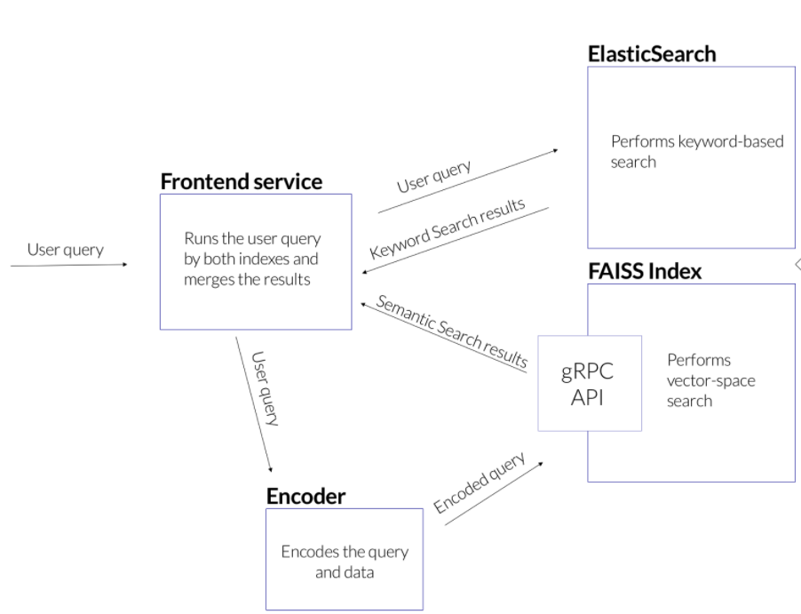
Arsitektur elasticsearch
Elasticsearch pada FAQ Searching
Menggunakan 2 teknik pencarian: - elasticsearch
- vector space search
Elasticsearch cenderung lebih baik dalam pencarian pada query singkat Vector space lebih baik untuk mencari makna teks

Slide 26
Demo

Slide 27
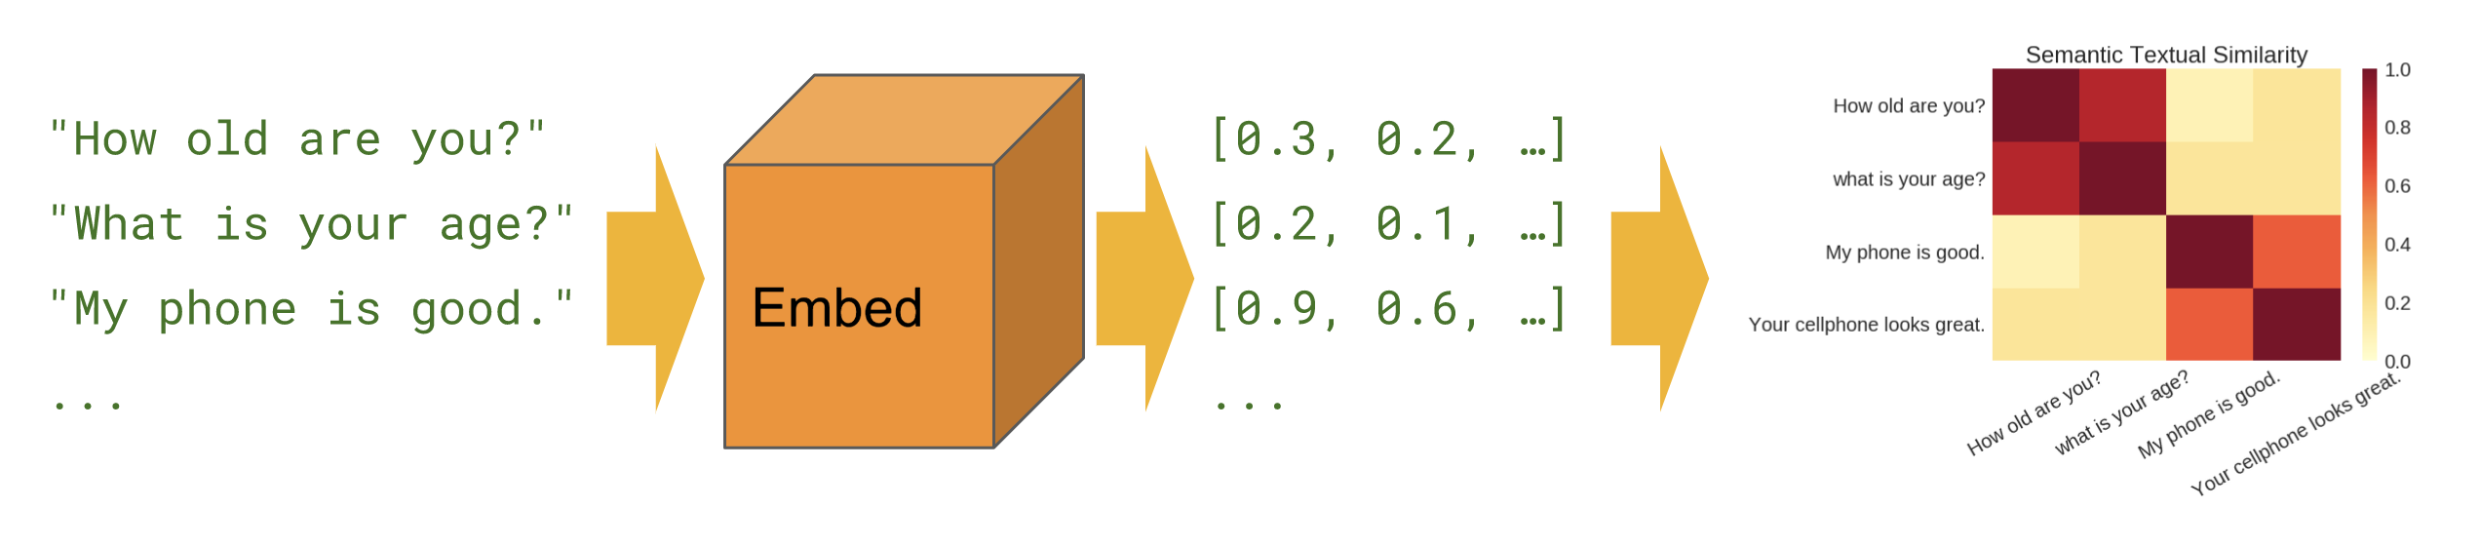
Semantic similarity

Slide 28
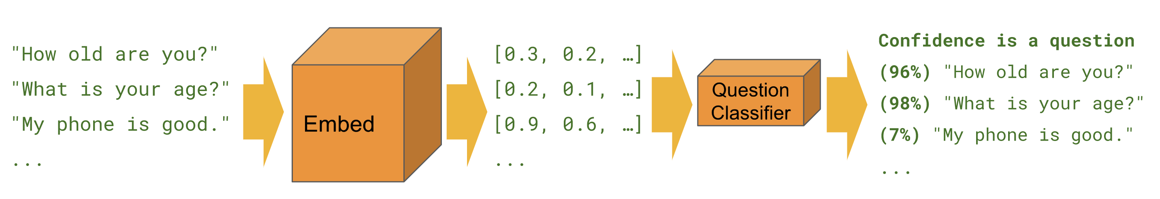
Semantic similarity

Slide 29




